Slide 1
Renaissance
Prepared by
Rupsikha Kalita
Assistant Professor
Dept. of History, PDUAM Dalgaon

Slide 2
Definition -
French word Renaissance (Rebirth).
Birthplace – Florence city of Italy
Factor –1453 (Turky occupied Constantinopole, scholars artists escaped to Italy and carried their knowledge with them)
Revival of interest in – art, literature, classical Greek and Roman culture, philosophy, humanism etc.
Began to question existing norms.
Why ?

Slide 3
Europe before Renaissance
Feudalism
Powerful Church
Agrarian economy
Limited literacy
Religious art dominated
Majority – rural
But now changed – towns, trade, universities, classical revival, wealthy merchants, etc.

Slide 4
Why Italy ?
Wealthy city states *Roman heritage *Mediterranean trade
Wealthy family patronage *Redisvovery of classical learning
Centres – Florence-Venice-Milan-Rome
Why Florence ?
Banking-commerce *wealthy patrons *Scholars-artists
Republican political culture
Medici family

Slide 5
The Rise of Humanism -
Central Idea –
Human beings possess reason, dignity and potential.
Humanists studied:📖 Literature🏛️ History🧠 Philosophy⚖️ Ethics🎭
RhetoricFamous phrase:“Studia Humanitatis”= Studies concerning human life and society

Slide 6
Medieval Thought vs Humanism -
Medieval emphasis Renaissance Humanism
God-centred world view
Greater focus on human beings
Theology
Humanities- Afterlife Worldly life also valued
Religious authority
Critical study of classical texts
Latin religious texts
Classical Greek & Roman literature

Slide 7
Francesco Petrarch“Father of Humanism”1304–1374
📚 Studied classical Latin texts
🏛️ Admired ancient Rome
✍️ Wrote poetry and letters
🔍 Encouraged critical study of ancient manuscripts
His goal: ➡️ “Back to the sources”

Slide 8
Renaissance Art 🎨
Renaissance artists developed -
*Realism
*Perspective
*Proportion
*Anatomy
*Light & shadow
*Individual portraits
*Interest in nature
*Art became more realistic.

Slide 9
LEONARDO DA VINCI1452–1519
🎨 Painter🔬
Scientist📐
Engineer🧠
Inventor✍️
Anatomist
Famous works: Mona Lisa, The Last Supper
Renaissance ideal: The “Universal Man” A person interested in many fields of knowledge

Slide 10
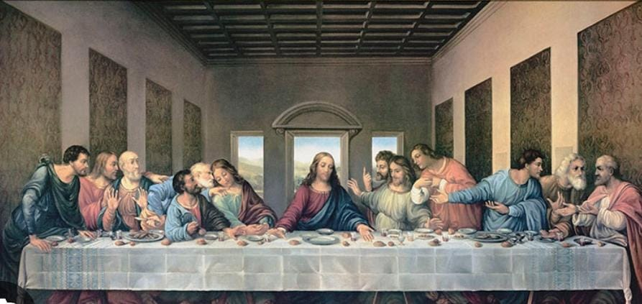
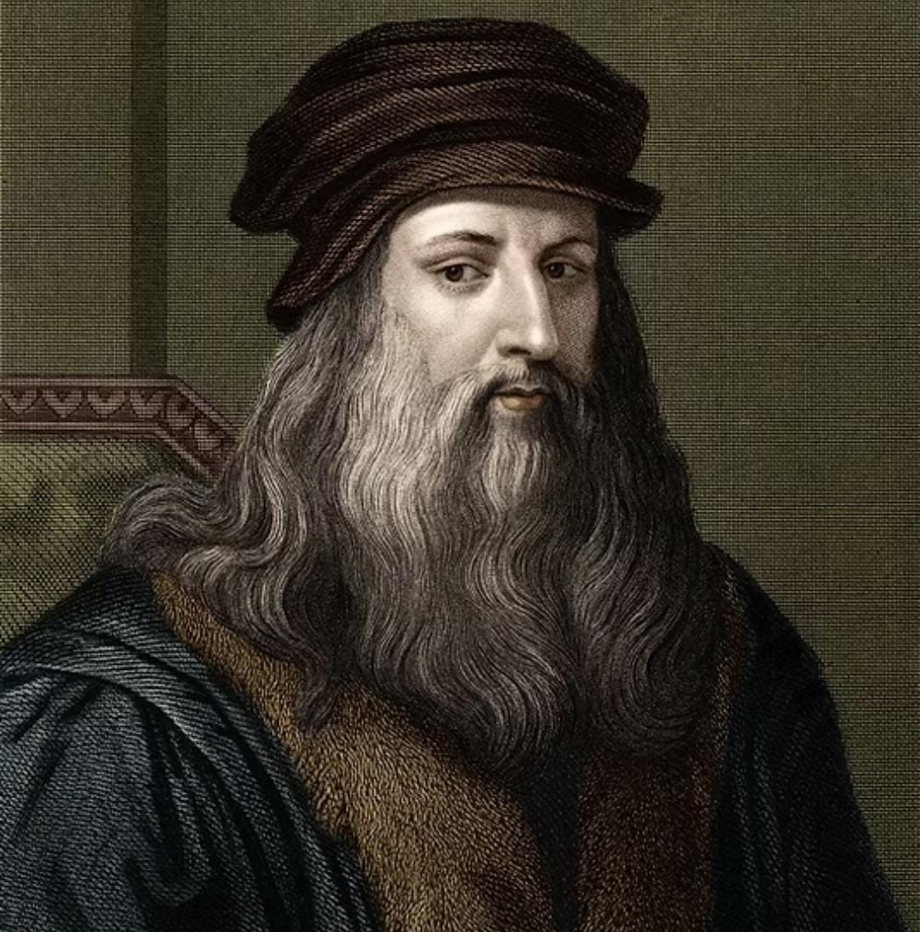
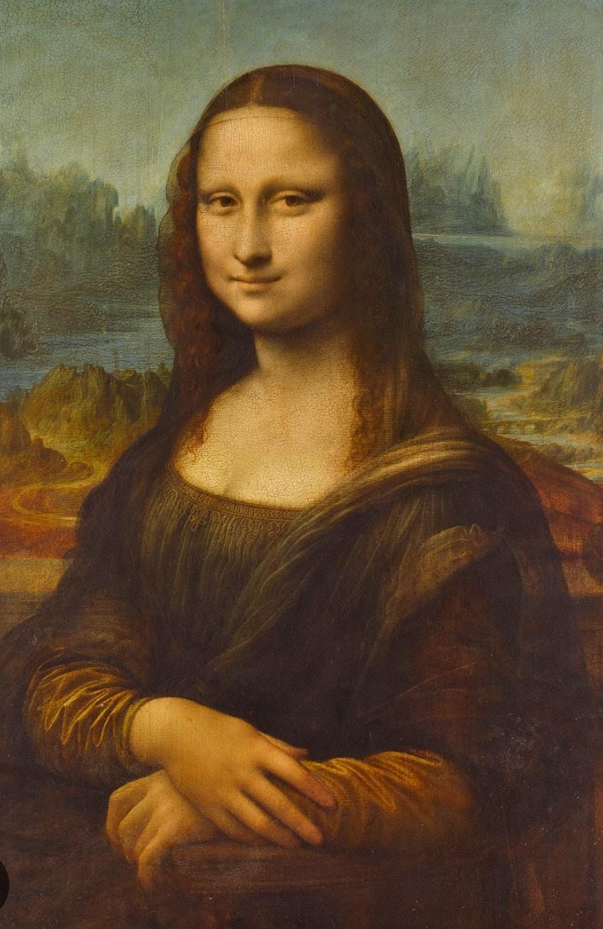
Vinci and his famous works – Monalisa (right) and the last supper (top)

Slide 11
Michelangelo1475–1564
🎨 Painter
🗿 Sculptor
🏛️ Architect
Famous works: David, Pietà, Sistine Chapel ceiling
Renaissance idea: Human body = beauty, strength and perfection

Slide 12
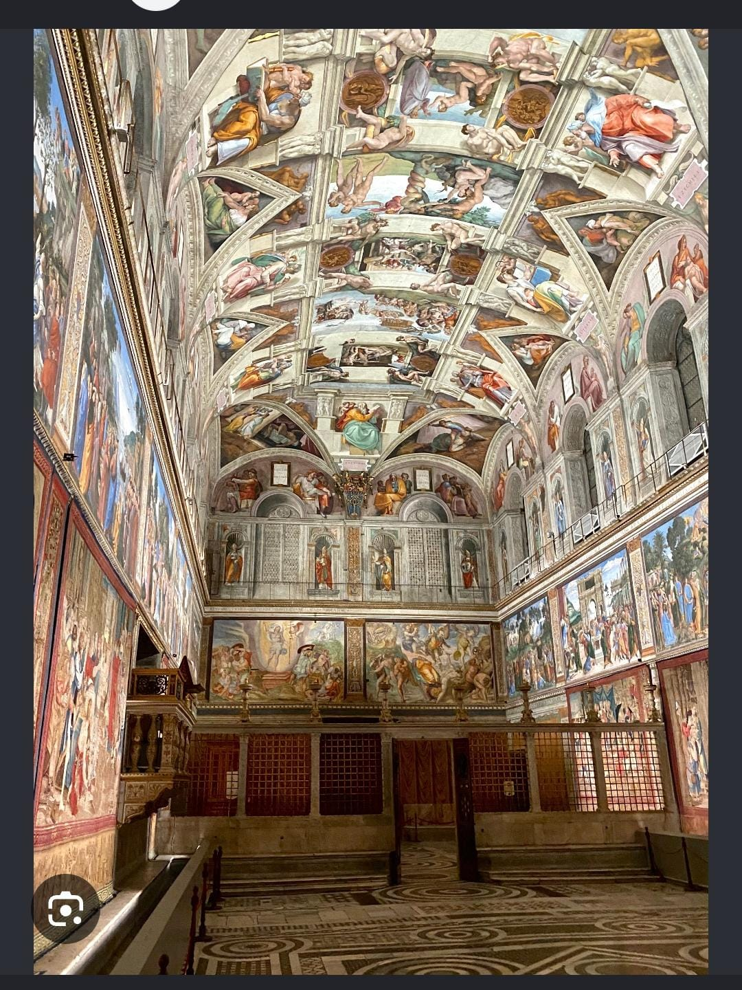
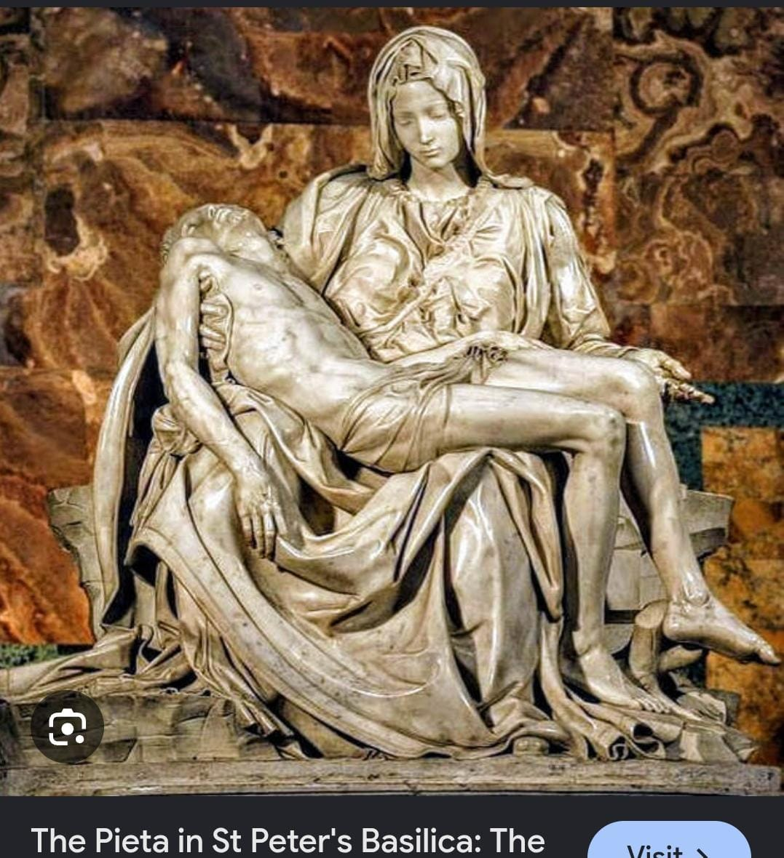
Pieta and Sistine Chapel ceiling by Michaelangelo

Slide 13
RAPHAEL 1483–1520
Famous for:
🎨 Harmony
📐 Balance
🙂 Idealised human figures
Famous painting: The School of Athens
It represents the glory of classical philosophy and knowledge.

Slide 14
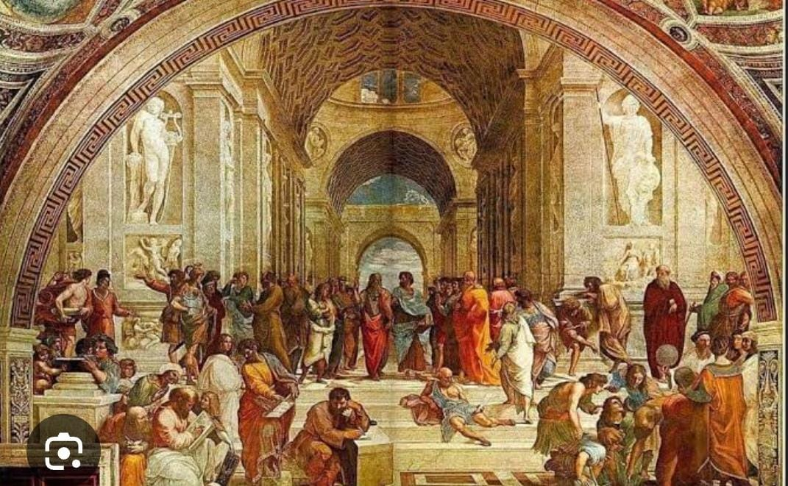
The school of Athens

Slide 15
Renaissance Literature
Literature became increasingly concerned with:
❤️ Human emotions
🏛️ Politics
⚔️ Society
😄 Everyday life
🧠 Individual personality
Important writers : Dante, Petrarch, Boccaccio, Machiavelli, Erasmus

Slide 16
Niccolò Machiavelli 1469–1527
Famous work:📖 The Prince
Central concern: How does political power actually work?
He studied: Power Politics, Leadership, Statecraft, Human behaviour,
Famous concept: Politics should be studied realistically, not only morally.

Slide 17
DESIDERIUS ERASMUS c. 1466–1536
Dutch humanist
Major ideas: Education, Moral reform, Criticism of corruption
Return to original Christian texts
importance of reason
📖 Famous work: In Praise of Folly

Slide 18
Gutenberg & the Printing Revolutionc. 1450s
Johannes Gutenberg developed movable-type printing in Europe.
Before printing:📜 Manuscripts✍️ Hand copying💰 Expensive books👥 Limited access
After printing:📚 More books💰 Cheaper books🌍 Faster spread of ideas📖 Increased literacy
Printing = 🚀 Information Revolution

Slide 19
Renaissance & Scientific Thinking
🔬Renaissance encouraged:
🔍 Observation❓
Questioning📐 Mathematics🌌 Study of nature🧪
Experimentation
Important figures: Copernicus → Heliocentric theory
Vesalius → Human anatomy
Galileo → Astronomy & observation
⚠️ Scientific Revolution developed later, but Renaissance intellectual culture helped create the environment for it.

Slide 20
Major Changes Brought by the Renaissance
🎨 Art -Realism & perspective
📚 Education -Humanities & classical learning
🧠 Intellectual life -Critical thinking
🖨️ Communication- Printing revolution
👤 Individual-Greater emphasis on individual personality
🔬 Knowledge - Growing interest in observation and nature
🏛️ Politics -More realistic study of power

Slide 21
Was the Renaissance Really a “Rebirth”?Think critically 🤔
Traditional interpretation: Renaissance = dramatic break from the Middle Ages
Modern historians argue: There was significant continuity between medieval and Renaissance Europe.
Therefore:❌ Medieval = completely backward❌ Renaissance = completely modern
Instead:✅ Renaissance = a period of important transformation within a longer historical process.

Slide 22
REMEMBER THE RENAISSANCE
Birthplace -Italy💰
Supported by -Trade + wealthy patrons
🧠 Intellectual movement- Humanism
🎨 Artists -Leonardo – Michelangelo – Raphael
📚 WritersPetrarch – Erasmus – Machiavelli
🖨️ Revolution -Printing Press
🔬 Legacy -New approaches to knowledge
⭐ Core idea: Greater interest in classical learning, human potential and the world around us.

Slide 23
If you were a Renaissance student, which would you choose?”
A. Study ancient Greek philosophy
B. Paint like Leonardo
C. Study politics like Machiavelli
D. Invent like Leonardo
E. Print and spread new ideas

Slide 24
Thank you !
Hope you enjoyed the class. Feel free to ask your doubts.

