Slide 1
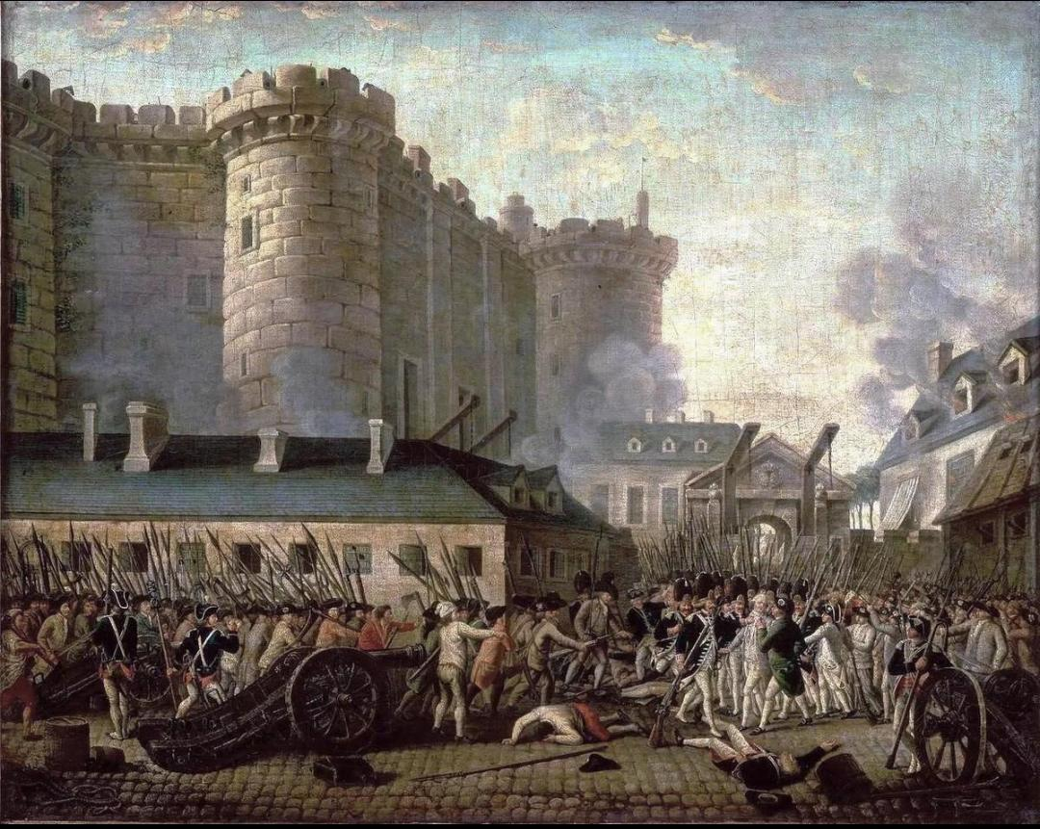
French Revolution
Presented by
Rupsikha Kalita
Assistant Professor
Dept. of History, PDUAM Dalgaon

Slide 2
The French Revolution (1789–1799) - From Absolute Monarchy to Republic
France before 1789
Causes of the Revolution
Major events, 1789–1799
Reign of Terror
Rise of Napoleon
"Why would ordinary people risk their lives to overthrow their king?"

Slide 3
France on the Eve of Revolution
France in the late 18th century
Absolute monarchy
King: Louis XVI
Social inequality
Financial crisis
Heavy taxation on common people
Enlightenment ideas spreading
Key idea:
France was politically powerful but internally unstable.

Slide 4
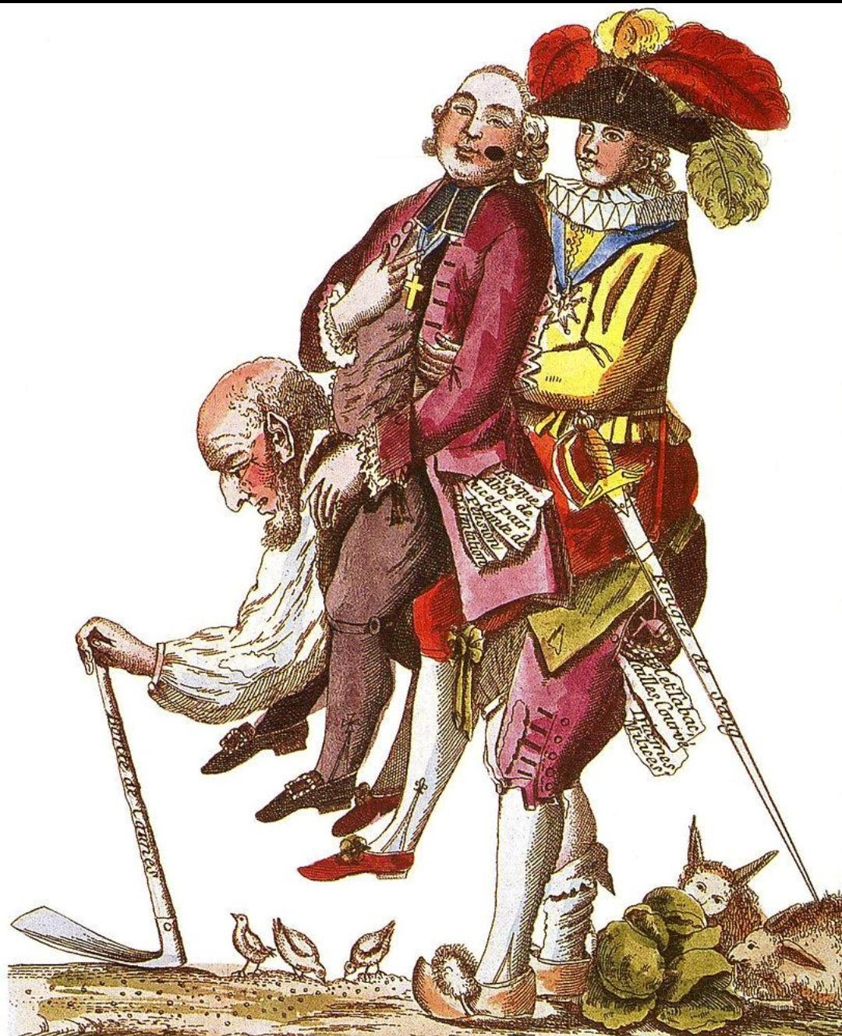
The Three Estates
First Estate
Clergy and Privileged
Second Estate
Nobility and Privileged
Third Estate
Peasants, workers, bourgeoisie and Majority
The Third Estate carried most of the tax burden.
Class question:
"Is equality possible when taxation is unequal?"

Slide 5
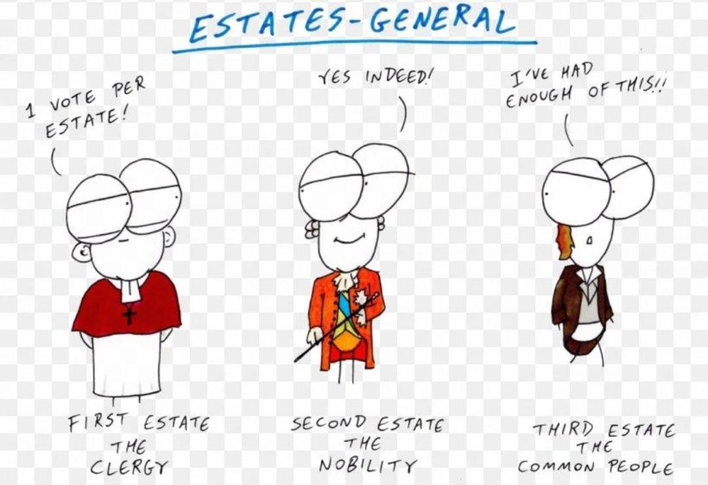
Estates general

Slide 6
Crisis of the Ancien Régime
Political
Absolute monarchy, Limited political representation
Social
Privileges of clergy and nobility, Feudal dues
Economic
Government debt, Heavy taxation, Rising bread prices
Intellectual
Enlightenment criticism of monarchy and privilege

Slide 7
The Enlightenment Connection
Important thinkers:
John Locke → natural rights
Montesquieu → separation of powers
Voltaire → criticism of religious and political authority
Rousseau → popular sovereignty and general will
Key concept:
“Sovereignty belongs to the people.”

Slide 8
The Financial Crisis
France was deeply in debt because of:
Costly wars
French support for the American Revolution
Royal expenditure
Inefficient taxation
Debt servicing
Louis XVI needed money.
So he called the Estates-General in 1789.

Slide 9
Estates-General, 1789 ,(5 May 1789)
Representatives of the three Estates met at Versailles.
The problem:
Should voting be:
By Estate?
→ First + Second Estates could dominate.
By Head?
→ Third Estate could have greater influence.
The dispute became a political crisis.

Slide 10
The Tennis Court Oath
20 June 1789
Members of the Third Estate declared themselves the:
National Assembly
They vowed:
Not to separate until France had a constitution.
Significance:
Political sovereignty was beginning to shift from the king toward the nation.

Slide 11
Storming of the Bastille - 14 July 1789
Paris crowds attacked the Bastille, a royal fortress and prison.
Why was it important?
Symbol of royal absolutism
People acquired weapons
Revolution spread
The king's authority was challenged
14 July became France's national day.

Slide 12
The Great Fear
During July–August 1789:
Peasants attacked manor houses
Feudal records were destroyed
Fear spread through the countryside
Night of 4 August 1789
The National Assembly abolished many feudal privileges.
Result:
The old social order began to collapse.

Slide 13
Declaration of the Rights of Man and Citizen - 26 August 1789
Inspired by Enlightenment ideas.
Major principles:
Liberty
Equality
Popular sovereignty
Freedom
Equality before law
Protection of property
Famous principle:
“Men are born and remain free and equal in rights.”

Slide 14
The Revolution and Women
Women played an important role.
Women's March on Versailles
5–6 October 1789
Thousands of women marched demanding:
Bread
Lower food prices
Action from the king
The royal family was forced to move to Paris.
Question:
"Were women participants only—or political actors in their own right?"

Slide 15
Constitutional Monarchy
1791 Constitution
France became a constitutional monarchy.
King retained executive authority
Legislative Assembly established
Political participation remained restricted
Property qualifications limited voting
But tensions continued…

Slide 16
Fall of the Monarchy 1792
France went to war with European monarchies.
Growing radicalism + economic crisis + fear of counter-revolution.
10 August 1792
Tuileries Palace was attacked.
September 1792
Monarchy was abolished.
France became a Republic.

Slide 17
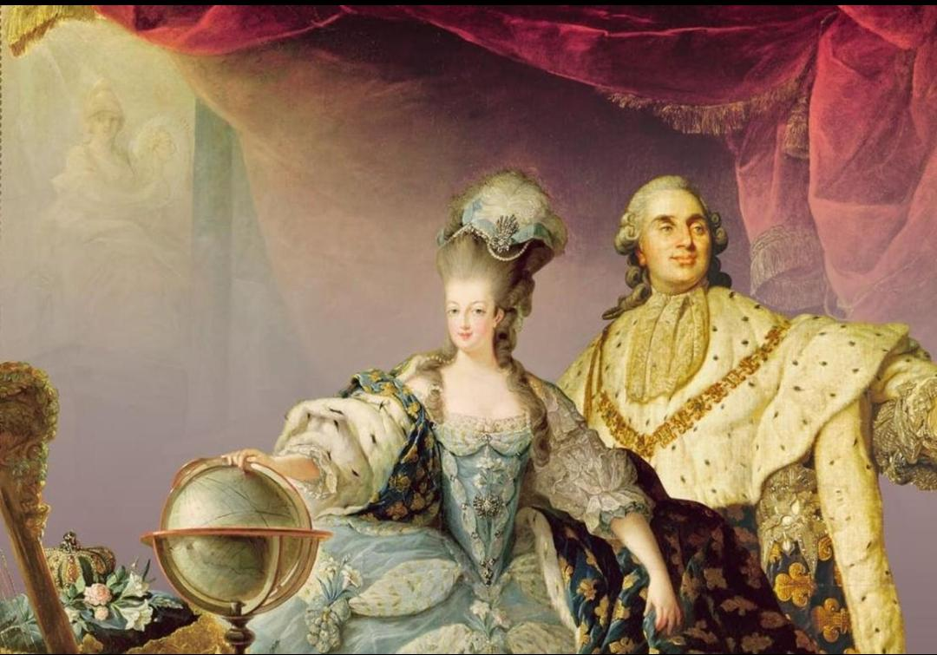
Execution of Louis XVI 21 January 1793
Louis XVI was executed by guillotine.
Why was this revolutionary?
The king was no longer viewed
as sacred and inviolable.
France had moved from:
Monarchy → Republic

Slide 18
The Reign of Terror (1793–1794)
Led by the Committee of Public Safety, associated especially with Maximilien Robespierre.
Reasons:
Foreign invasion, Civil war, Counter-revolution, Political factionalism
Methods:
Revolutionary Tribunal, Arrests, Executions, Guillotine
Thousands were executed.

Slide 19
Robespierre and the Fall of the Terror
Robespierre argued that:
“Terror is nothing other than justice…”
But fear eventually turned against the revolutionaries themselves.
27 July 1794 — 9 Thermidor
Robespierre was arrested.
28 July 1794
Robespierre was executed.
Result:
The Reign of Terror ended.

Slide 20
The Directory (1795–1799)
After the Terror:
Constitution of 1795
Executive power given to five Directors
Political instability
Economic problems
Corruption
Dependence on the army
The revolutionary government became increasingly weak.

Slide 21
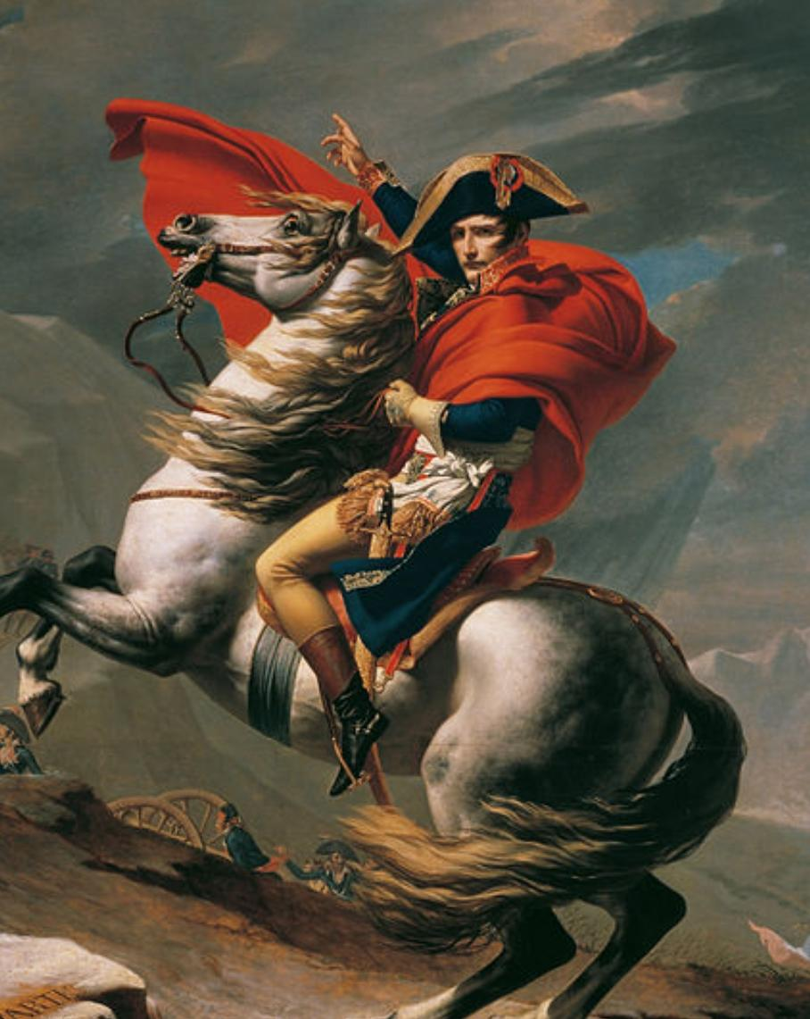
Rise of Napoleon
9 November 1799 — Coup of 18 Brumaire
Napoleon Bonaparte seized power.
Revolution's political decade:
Absolute Monarchy
↓
Constitutional Monarchy
↓
Republic
↓
Terror
↓
Directory
↓
Napoleon

Slide 22
Legacy of the French Revolution
Political
End of absolute monarchy, Republicanism, Popular sovereignty
Social
Attack on feudal privilege, Greater legal equality, Intellectual, Liberty
Equality, Citizenship, Rights, Global impact
Influenced political movements across Europe and the wider world.

Slide 23
The question -
Was the Revolution a Success
???

Slide 24
“The French Revolution failed politically but succeeded socially.”
* Positive - Feudal privileges weakened ,Equality before law , End of absolute monarchy , New ideas of citizenship
* Negative - Terror and political violence, Political instability, Napoleon's authoritarian rule, Women remained politically excluded
Exit question:
“What did the French Revolution change—and what did it fail to change?”

Slide 25
* If there is any doubt, feel free to ask .
THANK YOU !

